Slide 1

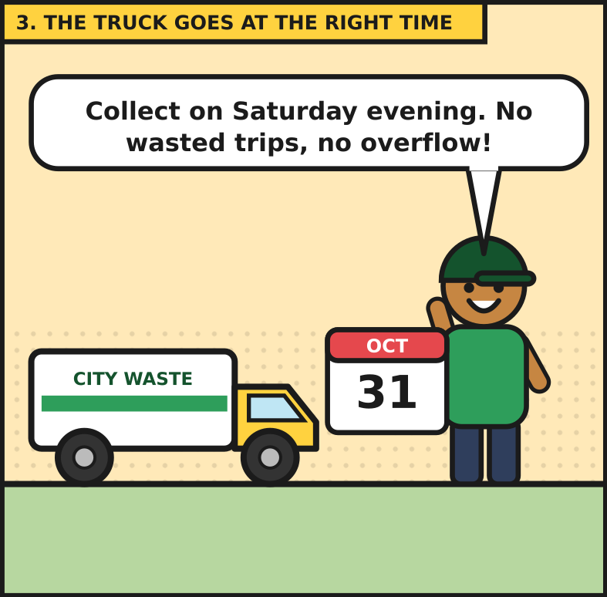
GROUP PROJECT REPORT
Smart Waste-Bin System
Predicting when a bin will be full, with multiple linear regression and a Streamlit web app

Slide 2
Group members
No. | Member name | Registration number
1 | Ndongozi Chris Arsene | 26RP00610
2 | HABUMUKIZA Bon Ange | 26RP00889

Slide 3
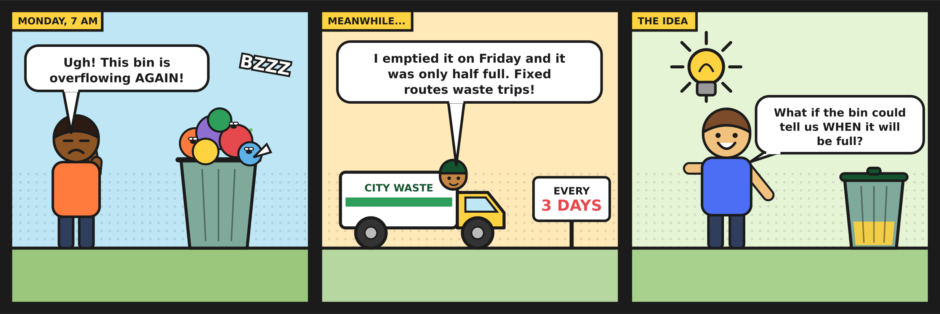
1. The problem
Waste trucks usually follow a calendar, but bins do not fill on a calendar. Some overflow before the truck arrives, and others are emptied while still half empty. Every wasted trip costs fuel and time, and every overflowing bin is a health and cleanliness problem for the neighbourhood.
Figure 1. The problem in three panels.
Our idea: build a web app that answers one question, when will this bin be full? With that answer, collection can be planned around the bin instead of around the calendar.

Slide 4
2. Solution overview
The project follows four steps, from raw sensor data to a hosted application.
Collect and clean. We started from the Kaggle smart-city sensor dataset and removed duplicates, spikes and gaps.
1
Train the model. A multiple linear regression predicts the hours left until the bin is full.
2
Save the equation. The intercept and coefficients are stored in a small file, metrics.json.
3
Serve it online. A Streamlit app offers three tabs: Predict, Model and data, and Admin.
4
Behind the scenes, the Admin tab reads the cleaned readings from PostgreSQL, or from a read-only SQLite copy when no database is connected.

Slide 5
3. Data preparation
The dataset is a synthetic smart-city collection with one waste bin (sensor IST-WASTE-003). It has no weight column and no record of when the bin was emptied, so part of the work was building those pieces ourselves.
Key figure | Value
Rows used for the model | 14,295
Level counted as full | 46 % (90 % of the typical peak fill)
Train / test split | Oldest 80 % / newest 20 % (split by time)

Slide 6
3. Data preparation: cleaning steps
The cleaning steps were:
Dropped duplicate timestamps and impossible values.
Removed spikes more than 20 points from the local median.
Filled gaps of up to 6 hours by interpolation.
Detected each pickup as a fill drop of more than 20 points.
Simulated weight (a 25 kg bin times the fill percentage), because the dataset has none.

Slide 7
4. The model
The model is one equation: the predicted hours until full equal an intercept plus the sum of each coefficient times its input. The app reads these numbers from metrics.json and does the arithmetic itself, so no machine learning library is needed online.
Input | Coefficient | What it means
intercept | 148.65 | Starting point, in hours
fill_pct | -0.0075 | Tiny; overlaps with other inputs
weight_kg | +0.0272 | Tiny; weight is simulated
hours_since_collection | -0.9918 | Main driver: about -1 hour per hour
avg_fill_rate | -0.0660 | Faster filling, less time left
hour | +0.0071 | Time of day, small effect
is_weekend | +1.1308 | Adds about 1.1 hours
Table 1. Regression coefficients saved by the training notebook.

Slide 8
4. The model: worked example
Worked example. With a fill level of 40 %, a weight of 8 kg and 24 hours since the last pickup, the equation returns about 124 h 45 min until the bin is full.
The fill percentage has a slightly negative coefficient, which looks odd at first. It comes from overlap with hours since collection and fill rate, which carry much of the same information.

Slide 9
5. Results
We compared three models on the newest 20 % of the data: a baseline that uses only the fill level, the full multiple linear regression, and a Ridge regression.
Model | MAE (h) | RMSE (h) | R-squared
Baseline (fill % only) | 12.93 | 16.31 | 0.857
MLR (all features) | 4.81 | 6.28 | 0.979
Ridge | 4.81 | 6.29 | 0.979
Table 2. Test-set results.
Using all six inputs cuts the average error by about 63 %, from 12.9 hours to 4.8 hours. Ridge gives practically the same numbers, so plain multiple linear regression is enough for this data.

Slide 10
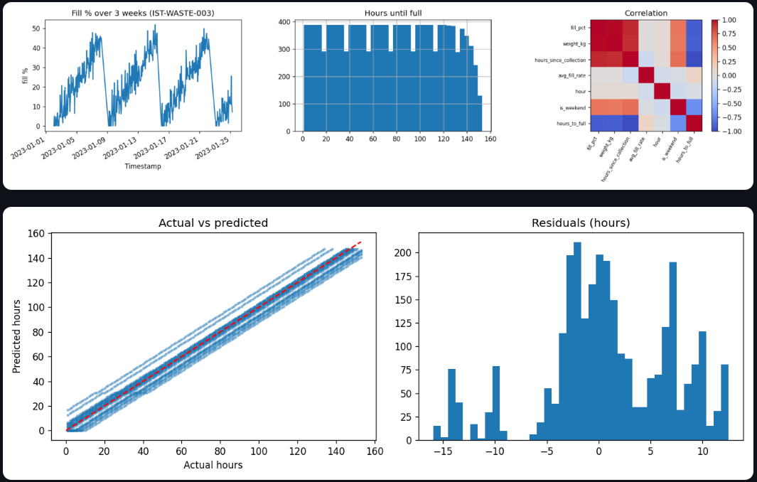
5. Results: data and fit
Figure 2. Data and fit. Bins fill and empty in weekly cycles, predictions follow the red line, and errors centre near zero (within about 15 hours).
A caution. The data is synthetic, covers one bin, and weight is simulated. The R-squared of 0.979 describes this dataset, not every real bin.

Slide 11
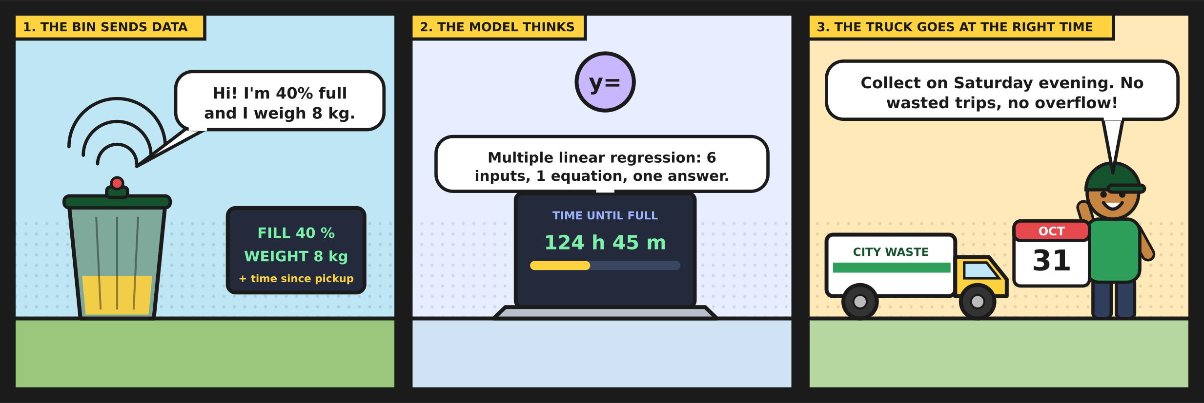
6. How the app works
Figure 3. Inputs in, hours out.

Slide 12
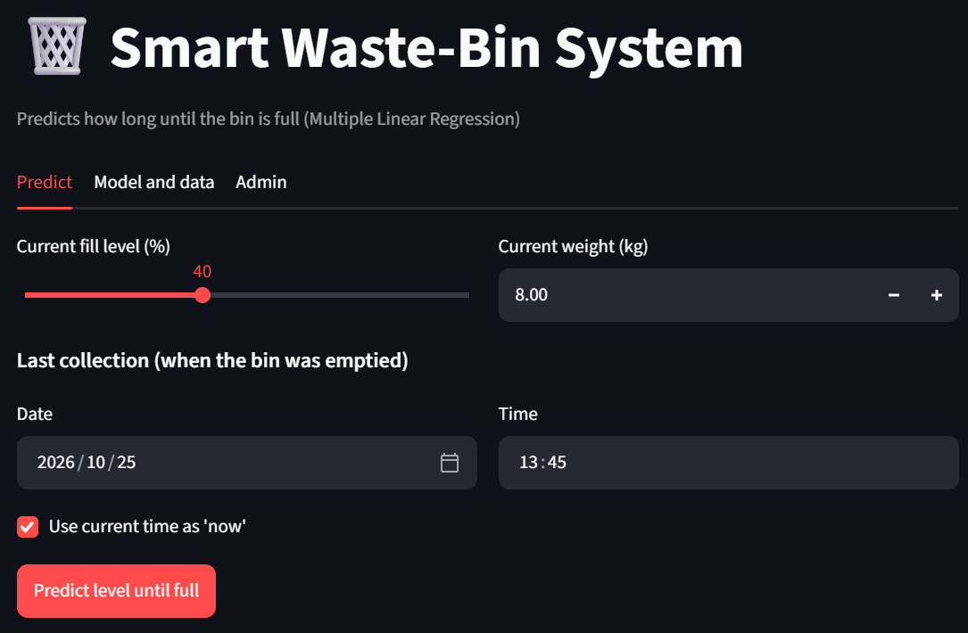
6.1 Predict tab
The user enters the current fill level, the weight, and the date and time of the last pickup. The app then builds the six features (hours since pickup, fill rate, hour of day, weekend flag, plus fill and weight), applies the equation, and shows the time left, the expected full date and a warning when collection is close.
Figure 4. Predict tab: entering the bin state.

Slide 13
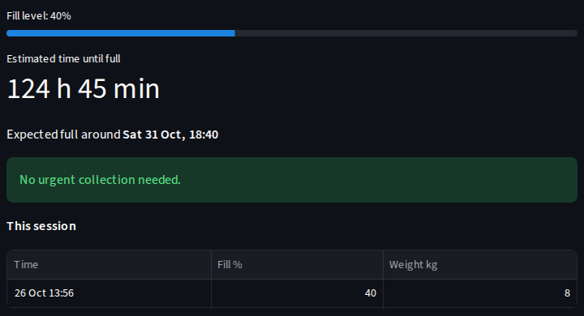
6.1 Predict tab: result
If the fill level is already at or above 46 %, the app tells the operator to collect now. Under 6 hours it shows a "Collect soon" warning.
Figure 5. Prediction result for fill 40 %, 8 kg, last pickup 24 hours ago.

Slide 14
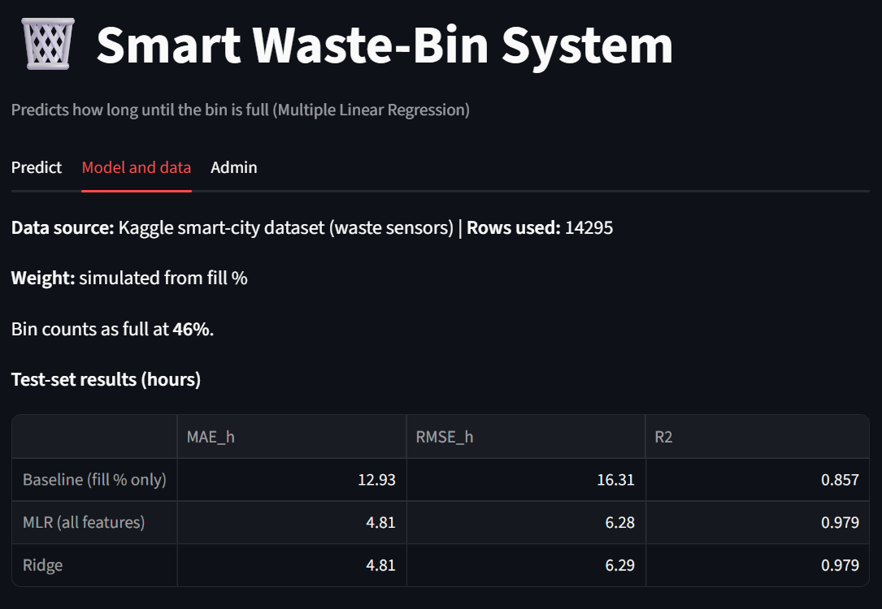
6.2 Model and data tab
This tab explains the answer. It shows the data source and row count, states openly that weight is simulated, compares the baseline, MLR and Ridge, lists the coefficients, and displays the data and evaluation charts. A user can see how far to trust a prediction.
Figure 6. Model and data tab.

Slide 15
6.3 Admin tab
The Admin tab protects the stored readings behind a login. Passwords are stored as PBKDF2 hashes, and a session is locked after five failed attempts. With PostgreSQL connected, admins can also create viewer and admin users. When no database is reachable, as on the hosted demo, the tab falls back to a read-only SQLite copy of the data with a single admin login kept in Streamlit Secrets, and offers a CSV download.

Slide 16
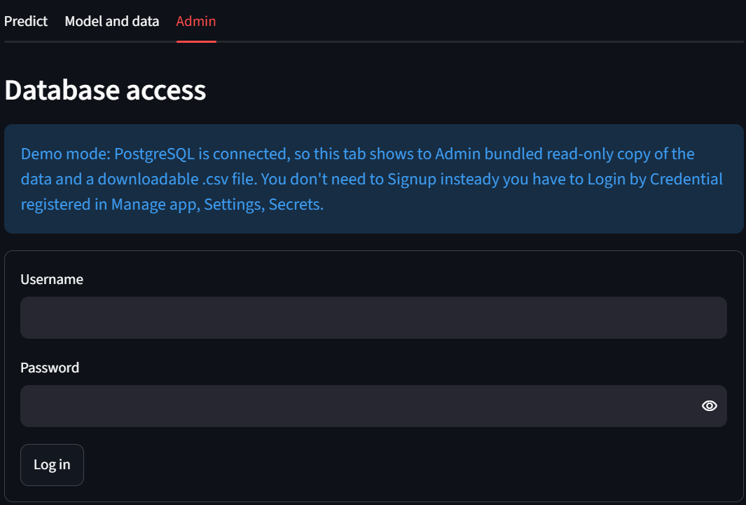
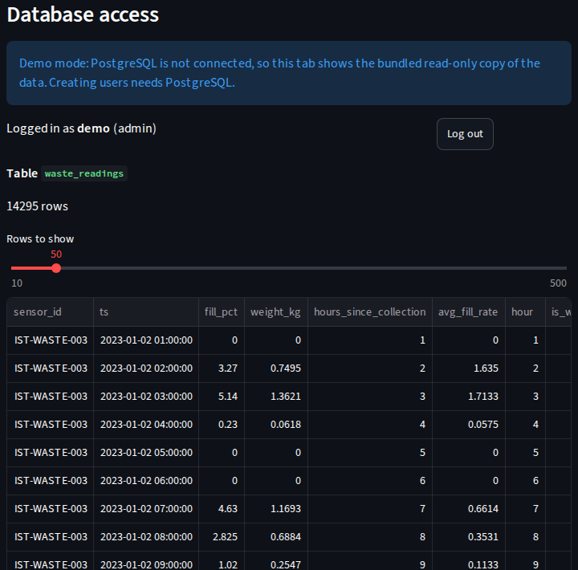
6.3 Admin tab: screenshots
Figure 7. Admin login on the hosted app.
Figure 8. Stored readings after login (local run).

Slide 17
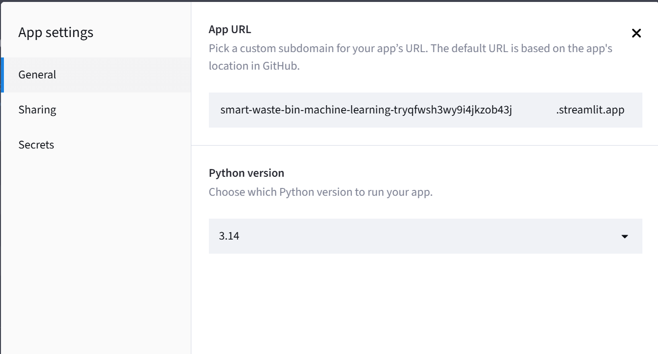
7. Hosting
The app is deployed from GitHub on Streamlit Community Cloud.
Push to GitHub. Code and artifacts go to the repository. The .env file stays out.
Streamlit builds it. Community Cloud installs only pandas, streamlit and psycopg.
Secrets hold logins. The admin user and password live in the app settings, never in the code.
Figure 9. Streamlit Cloud app settings.
Because predictions use the saved coefficients, the hosted app needs neither scikit-learn nor a model file.

Slide 18

A bug that taught us something
The Admin tab worked on a laptop but failed online. The PostgreSQL server we had installed only existed on that laptop, and the cloud could not reach it. The fix was a graceful fallback: the app checks what is available and uses PostgreSQL if it can, a read-only SQLite demo copy if it cannot, and a safe error message if a configured database is broken.
Figure 10. From "it worked on my laptop" to "it runs everywhere".

Slide 19
8. Project links
Item | Link
Hosted application | https://smart-waste-bin-machine-learning-tryqfwsh3wy9i4jkzob43j.streamlit.app/
Source code (GitHub) | https://github.com/NdongoziChrisArsene/Smart-Waste-Bin-Machine-Learning
Secondary dataset | https://www.kaggle.com/code/sumedh1507/smart-city-sensor-data-insights

Slide 20
9. Individual reflection
Ndongozi Chris Arsene · 26RP00610
My contribution
My part of the project covered the whole path from raw data to a hosted app. I cleaned the Kaggle sensor file, which turned out to be messier than I expected, and then worked out how to turn a stream of fill percentages into something we could predict: the hours left until the bin is full. After that I trained the regression, checked it against a fill-only baseline and a Ridge model, and wrapped it in a Streamlit app with a login-protected Admin tab. The last stretch was getting everything onto GitHub and Streamlit Cloud.

Slide 21
What I learned
The model was the easy bit. Deciding what "full" means, and spotting when a pickup had happened, took far more thought than calling a fit function. I also learned to be suspicious of my own coefficients: the fill percentage came out slightly negative, which made no sense until I remembered it overlaps with the time since collection. Splitting the data by time instead of at random showed me how easily a model can look better than it really is. And "it works on my machine" turned out to be a very different thing from "it is deployed".

Slide 22
Challenges I faced
Deployment was the hardest moment. The Admin tab ran perfectly on my laptop, then showed a database error online, because the PostgreSQL I had installed only existed on my machine. I rebuilt that part so the app checks what is reachable and falls back to a read-only demo copy, with the login kept in Streamlit Secrets so no password sits in GitHub. The data was the other hurdle: duplicates, gaps, spikes, no weight and no pickup record, so I had to simulate the weight and detect pickups myself. That also means the 0.979 R-squared describes this dataset, not every real bin.

Slide 23
What I would improve
Use real weight readings and real pickup records instead of simulated ones.
Train on many bins, and test a non-linear model against the linear one.
Connect a live sensor (an ESP32 or Raspberry Pi) and send SMS or email alerts.
Move to a cloud PostgreSQL database for full user management online, and add automated tests.

